Slide 1

AI-PRACTITIONERS
Raj Saraiya
Data Scientist
Aashay Bane
Data Scientist
Isabella Zhang
UX/UI Designer

Slide 2
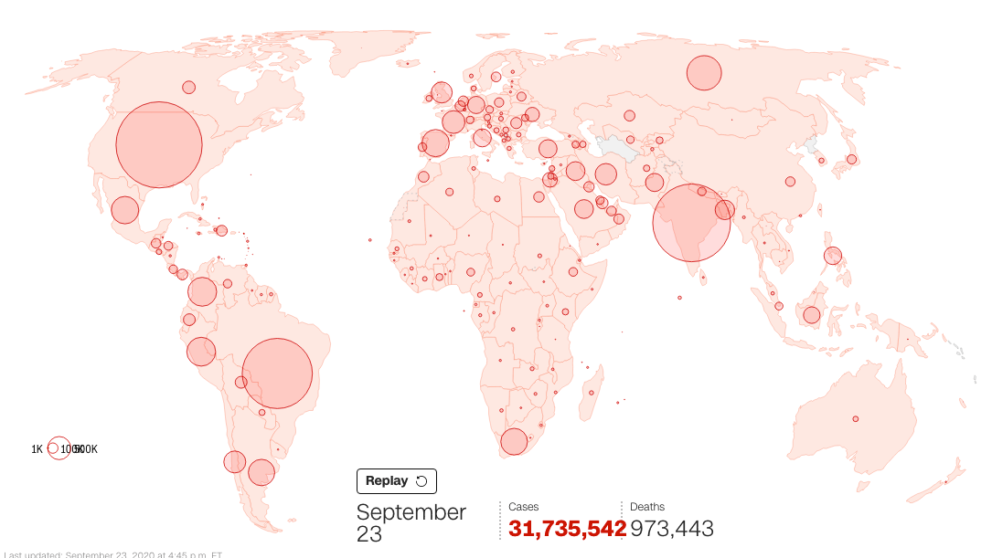




Schools
Manufacturers
Other crowd places
Militaries
AI-PRACTITIONERS
Notes:
In the Covid-19 pandemic, schools, manufacturers, military and other crowded places easier has outbreaks because people are not easy to keep physical distance in these places.

Slide 3
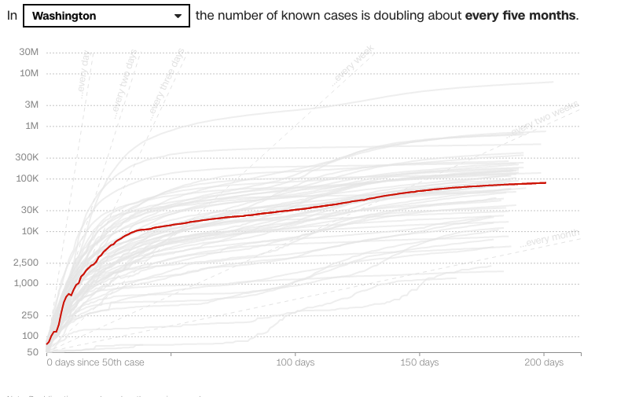
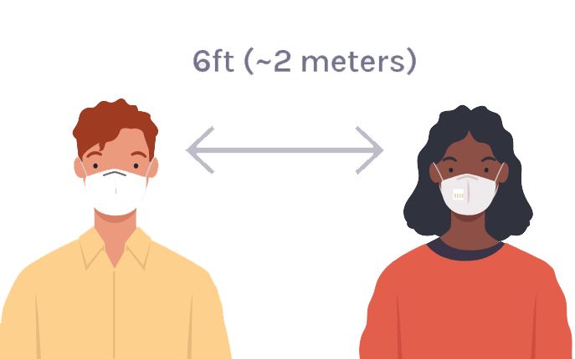
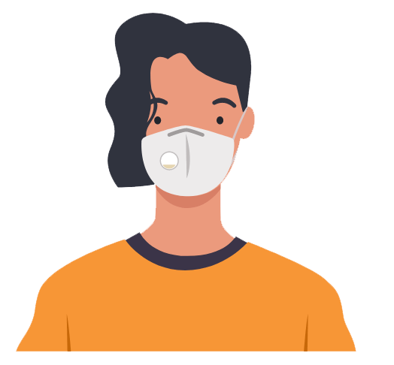

Keep Physical Distance
Wear a Mask
Wash Hands
AI-PRACTITIONERS
Notes:
To flat the curve and adopte to the new normal in the Covid-19 pandemic, people need to keep physical distance, Wear a mask and washing hand frequently.

Slide 4

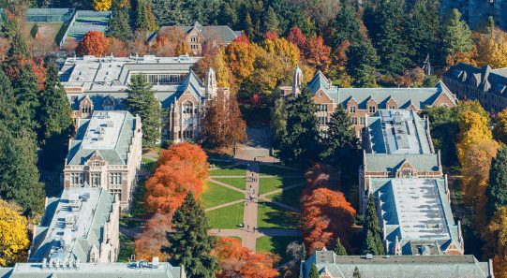
University of Washington
AI-PRACTITIONERS
Notes:
This fall, the university of washington plans to reopen the campus. However, the number of Covid-19 still is increasing in the United State and the United State still is remain the number 1 Covid-19 country in the world. How does the university of washington provides the virus-free environment for the students and teachers to have in-person classes? Eagle eye software can help.

Slide 5
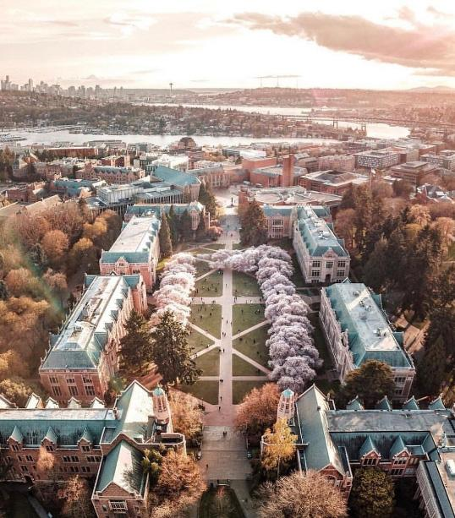
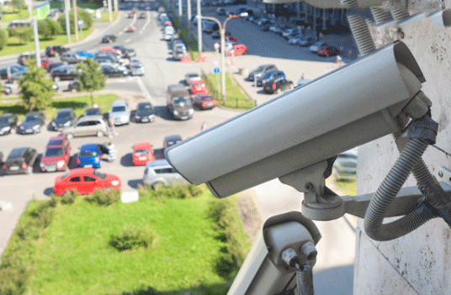
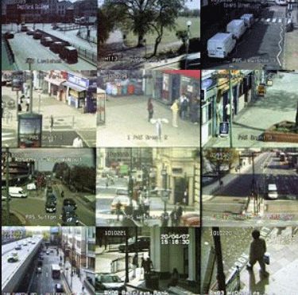
What is
AI-PRACTITIONERS
Notes:
Eagle Eye is a web-base Application that leverages AI technology and CCTV cameras to help the students and teachers of university of washington to adopt the new norms in Covid-19 pandemic by keeping physical distance and awareness of wearing the mask in the campus.

Slide 6
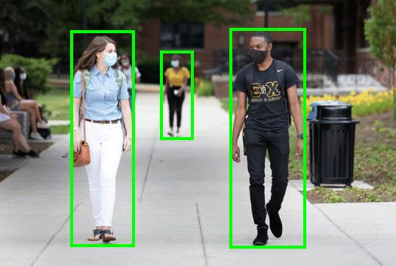
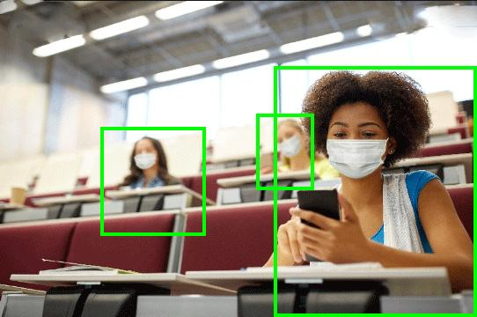
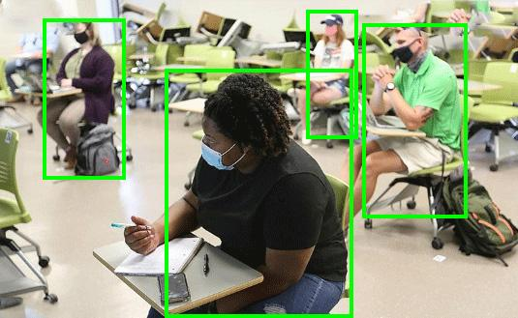
How does a Eagle Eye help University of Washington?
Monitors students/teachers activities and behaviors without compromising privacy.
AI-PRACTITIONERS
Notes:
Eagle Eye uses AI technology and CCTV cameras to monitor the students and teachers activities and behaviors without compromising privacy in the campus.
Put the green box on the photos.

Slide 7
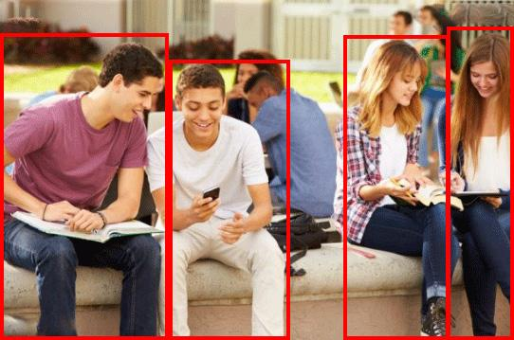
Features of Eagle Eye?
AI technology and accurate and fast face identity technology to detect the violators. Eagle Eye can detect who does not keep physical distance with others.
Violators
AI-PRACTITIONERS
Notes:
Eagle Eye uses AI technology and accurate and fast face identity technology to detect the people who does not keep physical distance with others right now. Eagle Eye can detect the people who does not wear a mask, who has a high temperature than normal, who has a record with positive COVID-19 in the future..

Slide 8
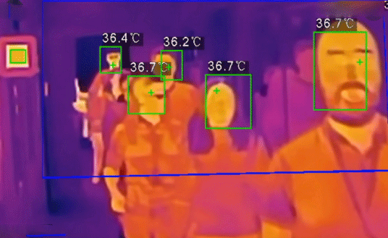
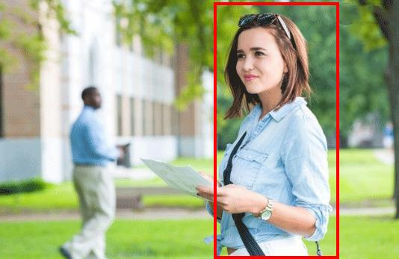
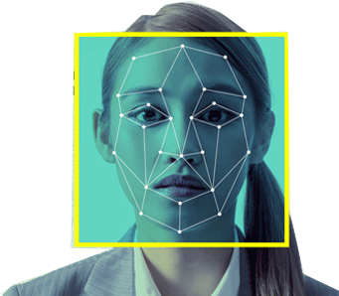

Features of Eagle Eye?
Eagle Eye can customize to detect who does not wear a mask; who has a high temperature than normal; who has a record with positive COVID-19 in 15 days as the customs’ need.
Violators
Violators
Violators
AI-PRACTITIONERS
Notes:
Eagle Eye can customize to detect the people who does not wear a mask, who has a high temperature than normal, who has a record with positive COVID-19 in the future as the customes’ need.

Slide 9
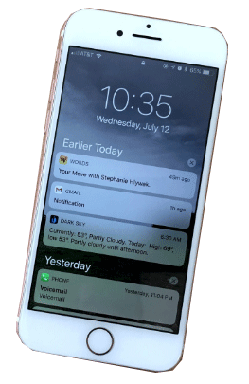

Features of Eagle Eye?
When Eagle Eye detects the violator, notifications will automatically be sent to the violators via phone text
When Eagle Eye detects the crowd violates the physical distance, an alarm will automatically be sent to the Eagle Eye’s administor.
Administor
AI-PRACTITIONERS
Notes:
When Eagle Eye detects the violator, notifications will automatically be sent to the violators via phone text. When Eagle Eye detects the crowd violates the physical distance, an alarm will automatically be sent to the Eagle Eye’s administor.

Slide 10
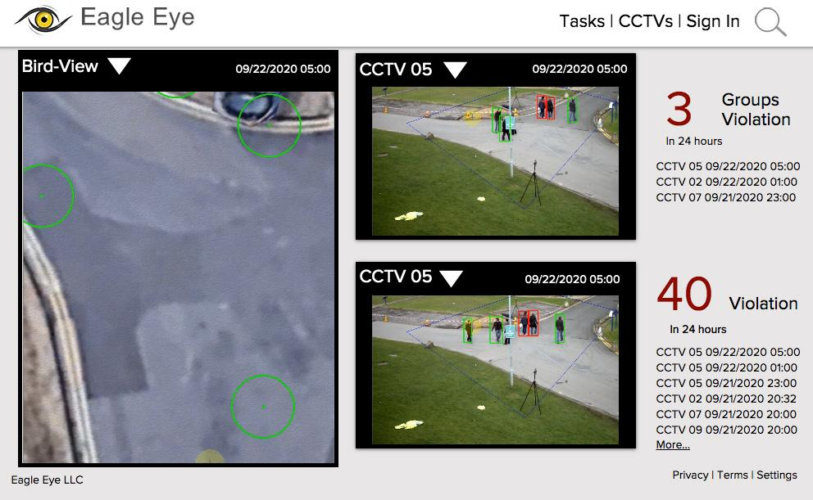
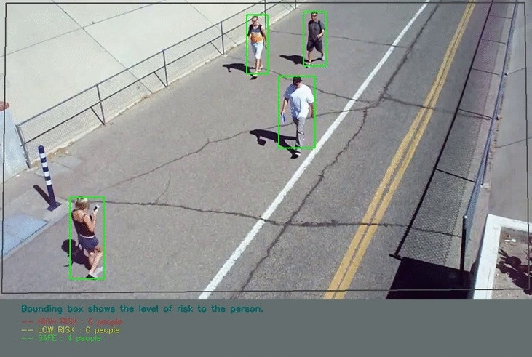
How does a Eagle Eye work?
Users (security employees) easily monitor the whole place and pay attention to the details by switching between birds-eye-view and real time view.
01
02
AI-PRACTITIONERS
Notes:
When the administrator use the Eagle Eye, Administor easily monitor the whole place and pay attention to the details by switching between birds-eye-view and real time view.

Slide 11

Eagle Eye’s future marketing
AI-PRACTITIONERS
Notes:
Eagle Eye not only helps Schools, Manufacturers, Militaries and other crowded places to reduce COVID-19 and provide the virus-free environment in COVID-19 pandemic, it also help the organizations to keep track the people for other disaster, such as Flu, keep track suspicion or dangerous activities and focus on objective detection in the crowd.

Slide 12
AI-PRACTITIONERS
DEMO
Notes:
Let’s move to Demo session.

Slide 13

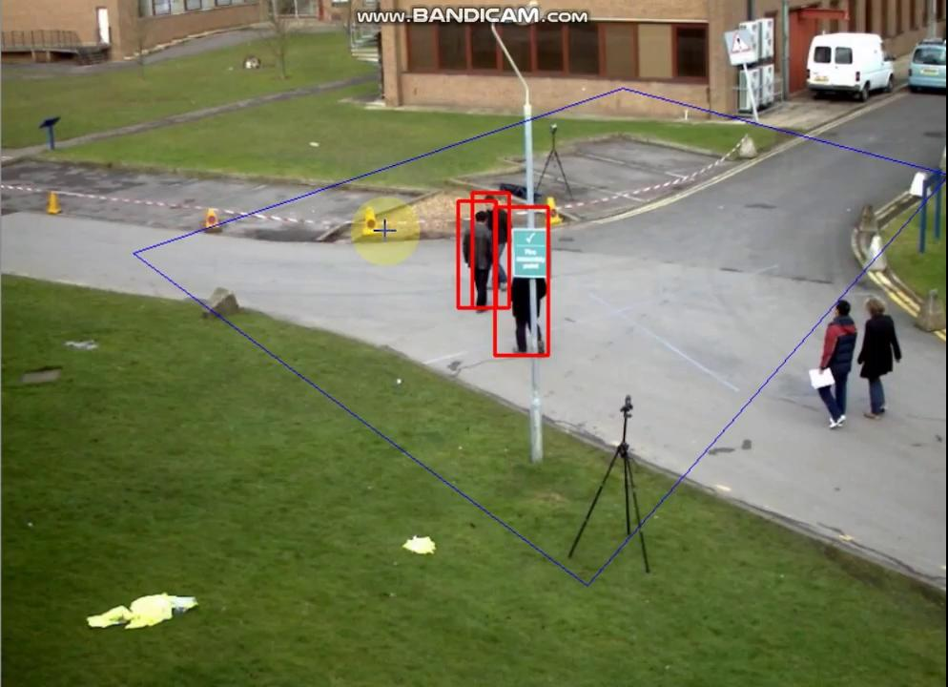

Slide 14

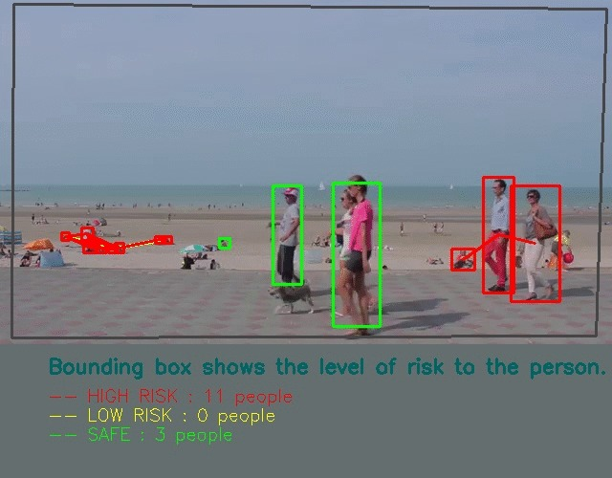
CCTV 01

Slide 15
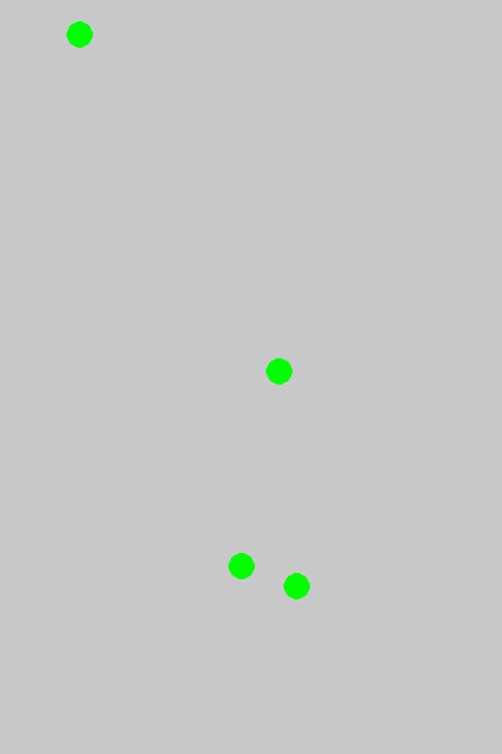
CCTV 02

